Slide 1




MINI PROJECT
TaskFlow
A Todo Management App
Built with Django (Full Stack Python)
Authentication
Categories
Priorities
Due Dates
Submitted by: K. Ravi Teja (24AK5A0428) | P. Mani Kumar (24AK5A0417) | G. P. Ravi Teja (24AK5A0427)

Slide 2

Problem Statement
Manually managing daily tasks using paper notes or generic note apps is inefficient and error-prone.
Most basic to-do apps lack personalization — they don’t support organizing tasks by importance, category, or deadline.
Users need a secure, multi-user platform where they can:
Track tasks by priority (High / Medium / Low)
Organize tasks into custom categories
Set due dates and get overdue alerts
Keep personal data private with login-based access
The Goal
A single, secure web app to plan, prioritize, and track personal tasks — anytime, anywhere.
Why Django?
Rapid development, built-in auth & admin, secure ORM, and clean MVT architecture.

Slide 3
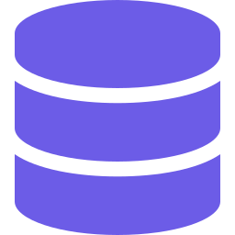

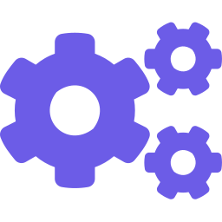


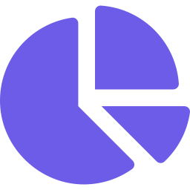
Methodology / Approach
Built using Django’s MVT (Model-View-Template) architecture
1. Data Modeling
2. Authentication
3. CRUD Logic
Designed Todo & Category models linked to Django's User model via ForeignKey relationships.
Implemented secure Register / Login / Logout using Django's built-in auth system.
Built views for Create, Read, Update, Delete with form validation using ModelForms.
4. Filtering & Search
5. UI Design
6. Dashboard
Added dynamic filters for status, priority, category and keyword search via QuerySets.
Crafted a responsive interface with Bootstrap 5 and a custom purple-gradient theme.
Added live stats cards showing total, pending, and completed task counts.

Slide 4





Results / Outcome
A fully functional, multi-user Todo web application
Secure user registration & login — each user manages their own private tasks
My Tasks
Custom, color-coded categories (Work, Personal, Study, etc.)
12
5
7
Total
Pending
Done
Priority tagging — High / Medium / Low with color indicators
Finish report
Due date & time tracking with automatic overdue highlighting
Work
Live search and multi-filter (status, priority, category)
Buy groceries
Personal
Full CRUD — add, edit, mark complete/incomplete, delete tasks
Prepare slides
Study

Slide 5

Conclusion
TaskFlow demonstrates a complete full-stack Python web application built on Django’s MVT architecture.
It covers key full-stack development skills:
Relational database design with ForeignKey relationships
User authentication & session management
Form handling, validation, and CRUD operations
Responsive, modern frontend design with Bootstrap 5
Future Enhancements
Email reminders for due tasks
Drag-and-drop task reordering
Dark mode toggle
REST API for mobile app integration

Slide 6
Thank you!
Future Enhancements
TaskFlow — Mini Project Presentation
K. Ravi Teja, P. Mani Kumar, G. P. Ravi Teja | ECE, AITS Tirupati | github.com/ra816

